Slide 1

SWE 321: Data Communication
SWE 321- Lecture 04
Afsana Begum
Department of Software Engineering
Daffodil International University

Slide 2
Overview:
Review
Data Transmission
Analog & Digital Signal
Analog Signal Analysis
Digital Signal Analysis
Time & Frequency Domain
Digital Signal Transmission
Channel Capacity
Transmission Impairments

Slide 3
Review:
  OSI Model
  Layer 1 - The Physical Layer
  Layer 2 - The Data Link Layer
  Layer 3 - The Network Layer
  Layer 4 - The Transport Layer
  Layer 5 - The Session Layer
  Layer 6 - The Presentation Layer
  Layer 7 - The Application Layer

Slide 4
Data Transmission:
Analog & Digital Data:
Analog Data:
The term Analog data refers to information that is continuous; such as the sounds made by a human voice, take on continuous values.
Digital Data:
Digital data refers to information that has discrete states. For example, data are stored in computer memory in the form of Os and 1s.

Slide 5
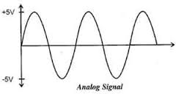
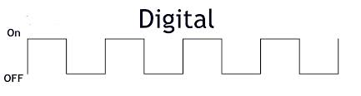
Data Transmission:
Analog & Digital Signal:
A signal is any function that carries information. Signals can be analog or digital. Analog signals can have an infinite number of values in a range; Digital signals can have only a limited number of values.

Slide 6

Data Transmission:
Analog Signal Analysis:
Analog signal can be represented by three parameters: the peak amplitude, the frequency, and the phase.
Peak Amplitude:
The peak amplitude of a signal is the absolute value of its highest intensity, proportional to the energy it carries. For electric signals, peak amplitude is normally measured in volts.

Slide 7
Data Transmission:
Analog Signal Analysis:
Period & Frequency:
Period refers to the amount of time, in seconds, a signal needs to complete 1 cycle.
Frequency refers to the number of periods in 1s.
Frequency is the rate of change with respect to time. Change in a short span of time means high frequency. Change over a long span of time means low frequency.
Frequency and period are the inverse of each other.

Slide 8
Data Transmission:
Analog Signal Analysis:
Phase:
The term phase describes the position of the waveform relative to time O.
Phase is measured in degrees or radians. A phase shift of 360° corresponds to a shift of a complete period; a phase shift of 180° corresponds to a shift of one-half of a period; and a phase shift of 90° corresponds to a shift of one-quarter of a period.

Slide 9
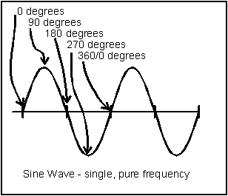
Data Transmission:
Phase Shifting:

Slide 10
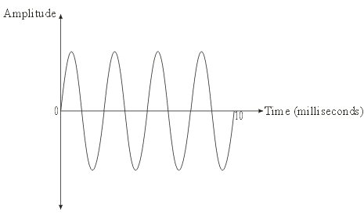
Data Transmission:
Time and Frequency Domains:
Time Domains:
The time-domain plot shows changes in signal amplitude with respect to time (it is an amplitude-versus-time plot). Phase is not explicitly shown on a time-domain plot.

Slide 11
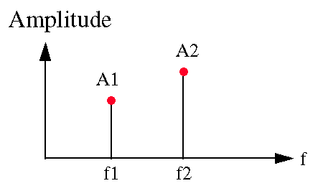
Data Transmission:
Time and Frequency Domains:
Frequency Domains:
Frequency-domain plot is concerned with only the peak value and the frequency. Changes of amplitude during one period are not shown.
The advantage of the frequency domain is that we can immediately see the values of the frequency and peak amplitude. A complete sine wave is represented by one spike. The position of the spike shows the frequency; its height shows the peak amplitude.

Slide 12
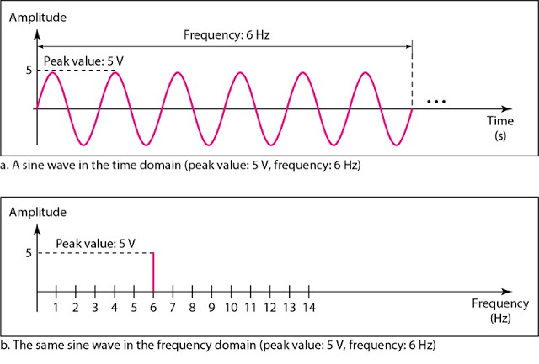
Data Transmission:
Time and Frequency Domains:

Slide 13
Data Transmission:
Bandwidth:
The bandwidth of a composite signal is the difference between the highest and the lowest frequencies contained in that signal.
Example: If a periodic signal is decomposed into five sine waves with frequencies of 100, 300, 500, 700, and 900 Hz, what is its bandwidth?
Solution: Let fh be the highest frequency, fl the lowest frequency, and B the bandwidth. Then B =fh - fl = 900 - 100 =800 Hz

Slide 14
Data Transmission:
Digital Signal Analysis:
Bit Rate:
Most digital signals are non-periodic, and thus period and frequency are not appropriate characteristics. Another term bit rate is used to describe digital signals.
The Bit rate is the number of bits sent in 1s, expressed in bits per second (bps).
Example: Assume we need to download text documents at the rate of 100 pages per minute. What is the required bit rate of the channel?
Solution: A page is an average of 24 lines with 80 characters in each line. If we assume that one character requires 8 bits, the bit rate is
100 x 24 x 80 x 8 =1,536,000 =25600bps =25kbps=0.0244Mbps

Slide 15
Data Transmission:
Transmission of Digital Signals:
We can transmit a digital signal by using one of two different
approaches:
  Baseband Transmission
  Broadband Transmission
Baseband Transmission: Baseband transmission means sending a digital signal over a channel without changing the digital signal to an analog signal.
Broadband Transmission: Broadband transmission or modulation means changing the digital signal to an analog signal for transmission.

Slide 16
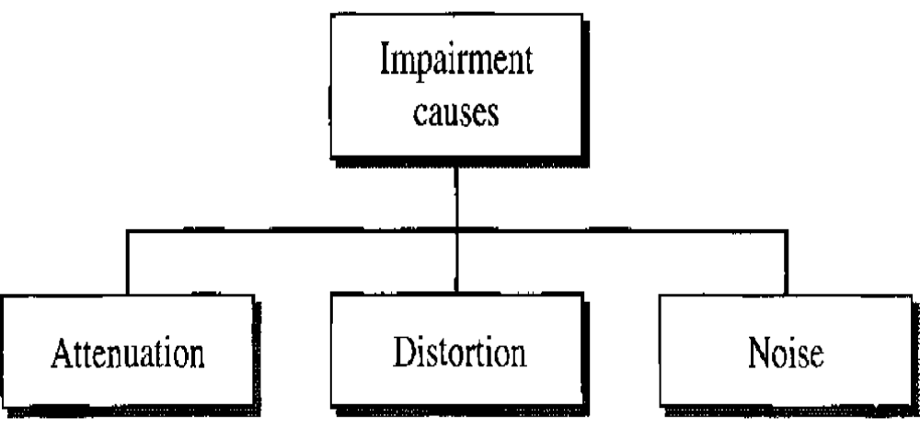
Data Transmission:
Transmission Impairment:
Signals travel through transmission media, which are not perfect. It means what is sent is not what is received.
Three types of impairment happens in data communication:

Slide 17
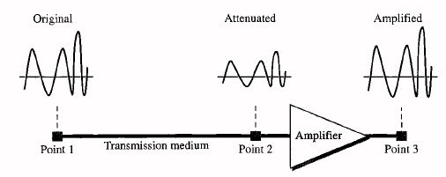
Data Transmission:
Attenuation:
Attenuation means a loss of energy. When a signal, simple or composite, travels through a medium, it loses some of its energy in overcoming the resistance of the medium.
Some of the electrical energy in the signal is converted to heat. To compensate for this loss, amplifiers are used to amplify the signal.

Slide 18
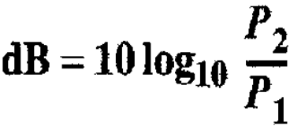
Data Transmission:
Attenuation Calculation:
To show that a signal has lost or gained strength, engineers use the unit of the decibel (dB).
Here, variables P1 and P2 are the powers of a signal at points 1 and 2, respectively.
Example: Suppose a signal travels through a transmission medium and its power is reduced to one-half. This means that P2 = ½ P1 In this case, the attenuation (loss of power) can be calculated as Attenuation = 10log10 (0.5) = -3 dB

Slide 19
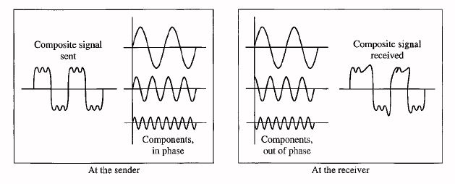
Data Transmission:
Distortion:
Distortion means that the signal changes its form or shape. Distortion can occur in a composite signal made of different frequencies.
Signal components at the receiver have phases different from what they had at the sender. The shape of the composite signal is therefore not the same.

Slide 20
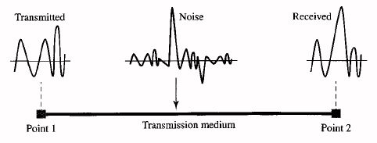
Data Transmission:
Noise:
Noise is refers to any unwanted signal. For any data transmission event, the received signal will consist of some additional unwanted signals that are inserted somewhere between transmission and reception these undesired signals are referred to as noise which is the major limiting factor in communications system performance.

Slide 21
Data Transmission:
Types of Noises:
Thermal noise: Thermal noise is the random motion of electrons in a wire which creates an extra signal not originally sent by the transmitter.
Induced noise: Induced noise comes from sources such as motors and appliances. These devices act as a sending antenna, and the transmission medium acts as the receiving antenna.
Crosstalk: Crosstalk is the effect of one wire on the other. One wire acts as a sending antenna and the other as the receiving antenna.
Impulse noise: Impulse noise is a spike that comes from power lines, lightning, and so on.

Slide 22

Data Transmission:
Signal-to-Noise Ratio (SNR):
Signal-to-Noise Ratio (SNR) is a measure used in science and engineering that compares the level of a desired signal to the level of background noise.
SNR is actually the ratio of what is wanted (signal) to what is not wanted (noise).
A high SNR means the signal is less corrupted by noise; a low SNR means the signal is more corrupted by noise.

Slide 23
Data Transmission:
Channel Capacity:
The maximum bit rate a transmission medium can transfer is called channel capacity of the medium.
The capacity of a channel, however, depends on the type of encoding technique and the signal-to-noise ratio of the system.
For example a normal telephone line with a bandwidth of 3000 Hz is capable of transferring up to 20,000 bps, but other factors, like noise, can decrease this rate.

Slide 24
Data Transmission:
Channel Capacity:
Shannon Capacity Theorem:
In reality, we cannot have a noiseless channel; the channel is always noisy. In 1944, Claude Shannon introduced a formula, called the Shannon capacity, to determine the theoretical highest data rate for a noisy channel.
Capacity =bandwidth x log2 (1 +SNR)
In this formula, bandwidth is the bandwidth of the channel, SNR is the signal-to-noise ratio, and capacity is the capacity of the channel in bits per second.

Slide 25
Data Transmission:
Shannon Capacity Theorem:
We can calculate the theoretical highest bit rate of a regular telephone line. A telephone line normally has a bandwidth of 3000 Hz (300 to 3300 Hz) assigned for data communications. The signal- to-noise ratio is usually 3162.
For this channel the capacity is calculated as C =B log2 (1 + SNR) =3000 log2 (l + 3162) =3000 log2 3163=3000 x 11.62 = 34,860 bps
This means that the highest bit rate for a telephone line is 34.860 kbps. If we want to send data faster than this, we can either increase the bandwidth of the line or improve the signal-to-noise ratio.

Slide 26
Data Transmission:
Performance Measurement:
One important issue in networking is the performance of the network-how good is it?
The following characteristics helps to measure the performance of Data transmission.
Bandwidth
Throughput
Latency (Delay)

Slide 27
Data Transmission:
Bandwidth:
In data communication, we use the term bandwidth in two contexts.
The first, bandwidth in hertz, refers to the range of frequencies in a composite signal or the range of frequencies that a channel can pass. For example, we can say the bandwidth of a subscriber telephone line is 3 kHz.
The second, bandwidth in bits per second, refers to the speed of bit transmission in a channel or link. For example, one can say the bandwidth of a Fast Ethernet network is a maximum of 100 Mbps.
Relationship: There is an explicit relationship between the bandwidth in hertz and bandwidth in bits per seconds. Basically, an increase in bandwidth in hertz means an increase in bandwidth in bits per second.

Slide 28
Data Transmission:
Throughput:
The throughput is a measure of how fast we can actually send data through a network. At first glance, bandwidth and throughput seem the same but they are not.
The bandwidth is a potential measurement of a link; the throughput is an actual measurement of how fast we can send data.
Imagine a highway designed to transmit 1000 cars per second from one point to another. However, if there is congestion on the road, this figure may be reduced to 100 cars per second. Here the bandwidth is 1000 cars per second and the throughput is 100 cars per second.

Slide 29
Data Transmission:
Throughput Calculation:
Example: A network with bandwidth of 10 Mbps can pass only an average of 12,000 frames per minute with each frame carrying an average of 10,000 bits. What is the throughput of this network?
Solution: We can calculate the throughput as
Throughput= 12,000 x 10,000 / 60 =2 Mbps
Here the throughput is almost one-fifth of the bandwidth in this case.

Slide 30
Data Transmission:
Latency (Delay):
The latency or delay defines how long it takes for an entire message to completely arrive at the destination from the time the first bit is sent out from the source.
We can say that latency is made of four components: propagation time, transmission time, queuing time and processing delay.
Latency = Propagation time + Transmission time +Queuing time + Processing delay

Slide 31
Data Transmission:
Propagation Time:
Propagation time measures the time required for a bit to travel from the source to the destination. The propagation time is calculated by dividing the distance by the propagation speed.
Propagation time = Distance / Propagation speed
Example: What is the propagation time if the distance between the two points is 12,000 km? Assume the propagation speed to be 2.4 x 10^8 m/s in cable.
Solution: We can calculate the propagation time as Propagation time = 12,000 x 1000 / 2.4 x 10^8 =0.005s=5ms
The example shows that a bit can go over the Atlantic Ocean in only 5 ms if there is a direct cable between the source and the destination.

Slide 32
Data Transmission:
Transmission Time:
In data communications we don't send just 1 bit, we send a message. The first bit may take a time equal to the propagation time to reach its destination; the last bit also may take the same amount of time.
The first bit leaves earlier and arrives earlier; the last bit leaves later and arrives later. The time required for transmission of a message depends on the size of the message and the bandwidth of the channel.
Transmission time =Message size / Bandwidth

Slide 33
Data Transmission:
Queuing Time:
The third component in latency is the queuing time, the time needed for each intermediate or end device to hold the message before it can be processed.
The queuing time is not a fixed factor; it changes with the load imposed on the network. When there is heavy traffic on the network, the queuing time increases.
An intermediate device, such as a router, queues the arrived messages and processes them one by one. If there are many messages, each message will have to wait.

Slide 34
Thanks…
Any Questions ???

